Slide 1


JAVASCRIPT

Slide 2
What is Javascript
JavaScript is a scripting or programming language that allows you to implement complex features on web pages — every time a web page does more than just sit there and display static information for you to look at — displaying timely content updates, interactive maps, animated 2D/3D graphics, scrolling video jukeboxes, etc. — you can bet that JavaScript is probably involved. JavaScript enables you to create dynamically updating content, control multimedia, animate images, and pretty much everything else. (Okay, not everything, but it is amazing what you can achieve with a few lines of JavaScript code.)

Slide 3
Why js is important ?
Client-Side Functionality – It makes websites interactive (e.g., animations, form validation, dynamic content updates).
Versatility – Works for front-end (React, Angular) and back-end (Node.js) development.
High Demand – Used in almost every modern web application.
Easy to Learn – Has a simple syntax, making it beginner-friendly.
Rich Ecosystem – Large community support, countless frameworks, and libraries.
Cross-Platform – Runs on browsers, servers, mobile, and even IoT devices.

Slide 4
JavaScript powers the entire MERN stack (MongoDB, Express.js, React, Node.js), which you are learning, making it essential for full-stack development.

Slide 5
What is a Variable?
Variables: We use programming languages like JavaScript to store and manipulate information. Variables in JavaScript are used to store different kinds of data. Think of a variable like a bottle. We use bottles to store water, in much the same way we use variables to store various forms of data in JavaScript.
var number = 200

Slide 6
JavaScript provides three ways to declare variables
var – Old way, function-scoped.
let – Block-scoped, can be reassigned.
const – Block-scoped, cannot be reassigned.
var name = "John";
let age = 25;
const city = "New York";
console.log(name, age, city);

Slide 7
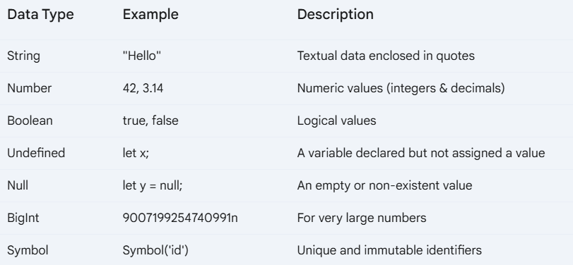
Data Types In Javascript

Slide 8
What are Data Types?
Data types define the type of data a variable can hold.
JavaScript has two main categories: Primitive and Non-Primitive.
Primitive Data Types
Definition:
Primitive data types are stored directly in memory.
Immutable (cannot be changed once created).
Types: String, Number, Boolean, Undefined, Null, BigInt, Symbol.
Non-Primitive Data Types
Definition:
Stored by reference in memory.
Includes Objects, Arrays, and Functions.

Slide 9
String
Definition:
A sequence of characters enclosed in quotes
let name = "Alice";
console.log(typeof name);
Number
Definition:
Represents both integers and floating-point numbers
let age = 25;
let pi = 3.14;
console.log(typeof age); // "number"

Slide 10
Boolean
Definition:
Represents true or false values.
let isStudent = true;
console.log(typeof isStudent);
Undefined
Definition:
A variable declared but not assigned a value.
let x;
console.log(typeof x);

Slide 11
Null
Definition:
Represents an empty or non-existent value.
let y = null;
console.log(typeof y);
BigInt
Definition:
Used for very large numbers beyond the safe integer limit.
let bigNumber = 9007199254740991n;
console.log(typeof bigNumber);

Slide 12
Symbol
Definition:
Used for unique identifiers.
let id = Symbol("id");
console.log(typeof id);

Slide 13
Non-Primitive Data Types
Object
Definition:
A collection of key-value pairs.
let person = { name: "Alice", age: 25 };
console.log(typeof person); // "object"
Array
Definition:
An ordered list of values.
let colors = ["red", "blue", "green"];
console.log(typeof colors);

Slide 14
Operators

Slide 15
Q. What is Operators
Definition:
Operators allow us to perform operations on data.
Mathematical operators in JavaScript
Comparison Operators (==, ===, !=, !==, >, <, >=, <=)
Logical Operators (&&, ||, !)
Conditional Operator
Ternary Operator (condition ? expr1 : expr2)

Slide 16
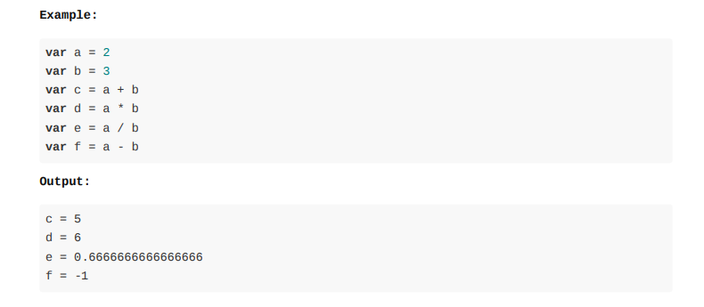
Mathematical operators in JavaScript
Common Operators : Javascript supports all the commonly used mathematical operators. Namely + - * / .

Slide 17
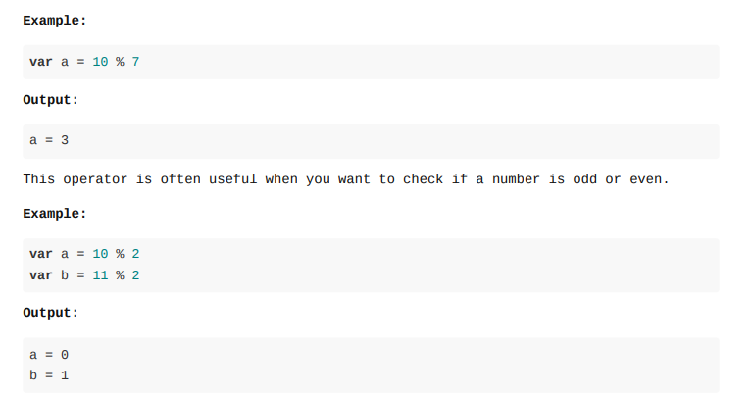
Modulo or Remainder Operator: Many programming languages including JavaScript have a modulo operator % . This operator returns the remainder when one variable is divided by another.

Slide 18
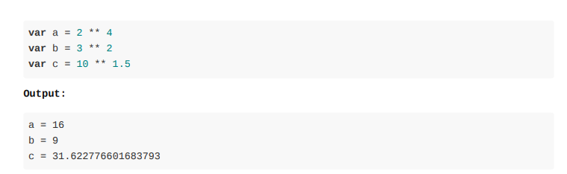
Exponentiation operator: This operator is represented by ** . This returns the value of the first operand raised to the power of the second operand.

Slide 19
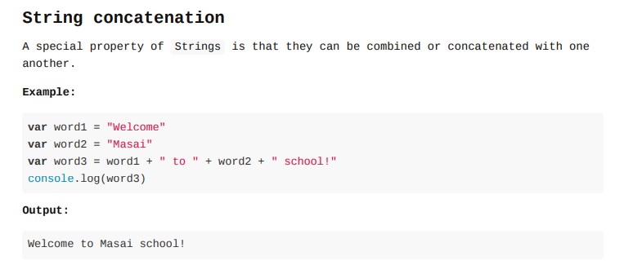

Slide 20
var num1 = 1
var num2 = 2
var output = "1 + 2 = " + (num1 + num2) console.log(output)

Slide 21
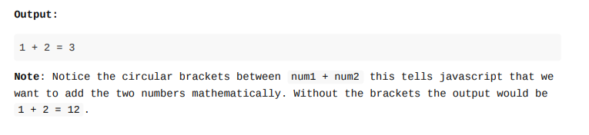
var num1 = 1
var num2 = 2
var output = "1 + 2 = " + (num1 + num2) console.log(output)

Slide 22
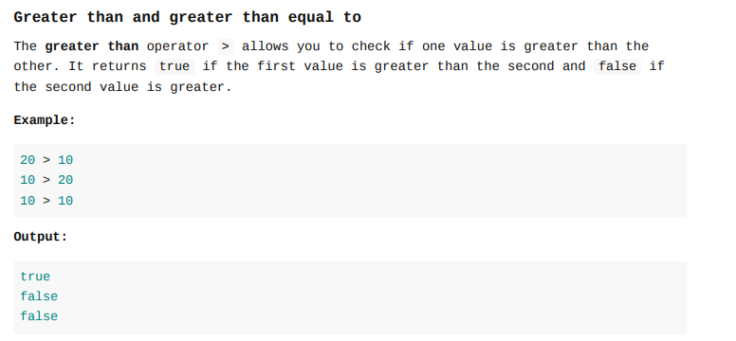
Relational operators(Comparison ) : These operators allow you to test the relation between 2 values and returns a boolean . JavaScript unlike other languages allows you to compare any type with any other type!

Slide 23
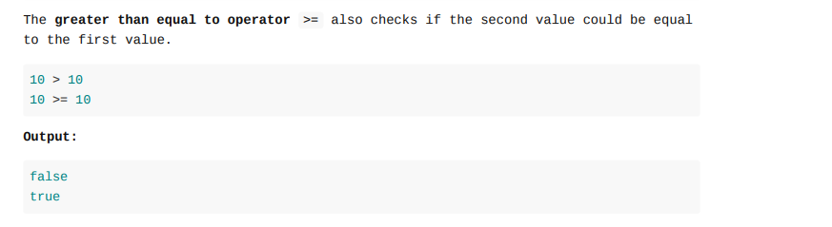

Slide 24
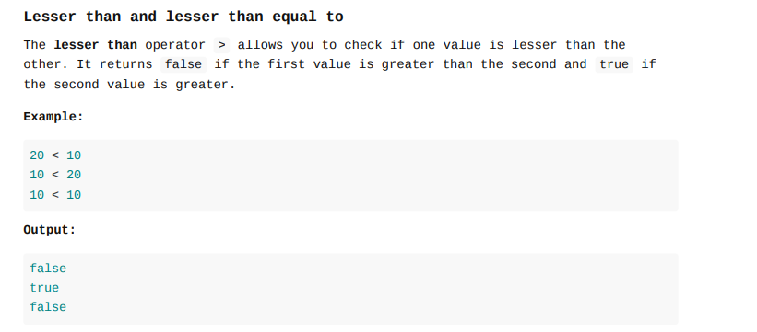

Slide 25

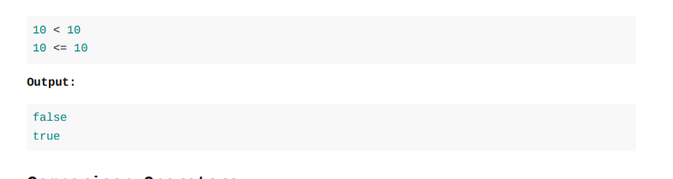

Slide 26
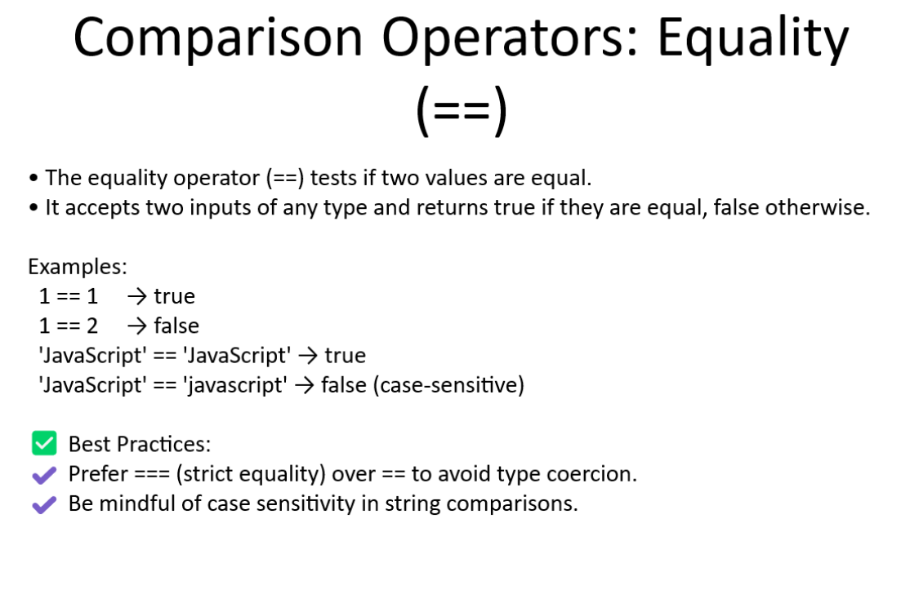

Slide 27
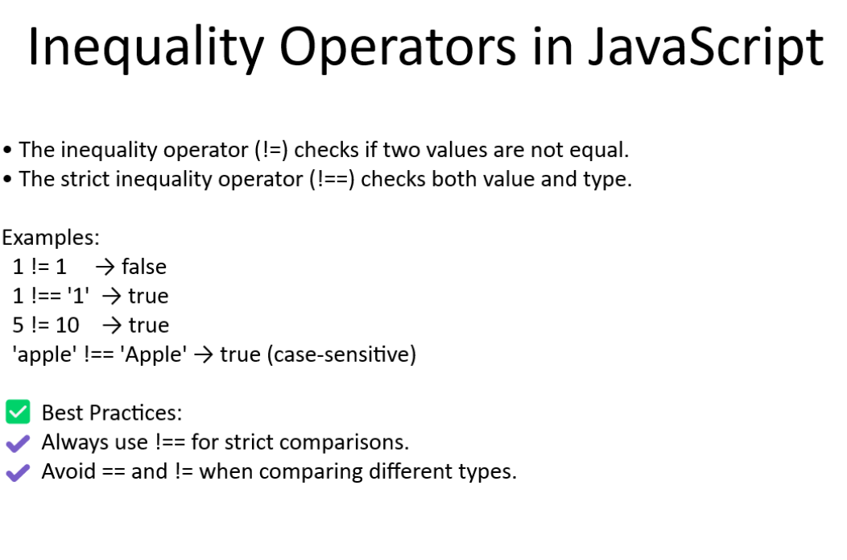

Slide 28
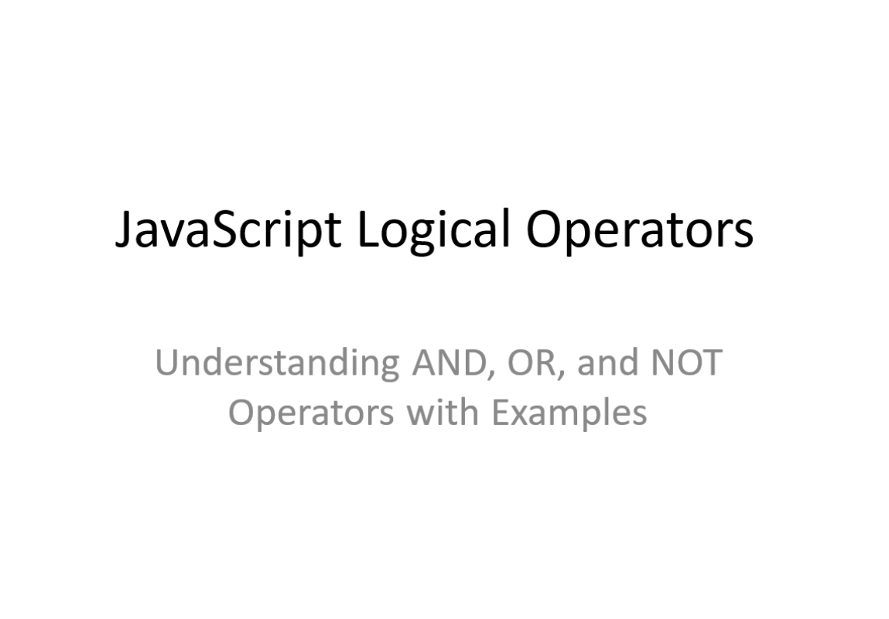

Slide 29
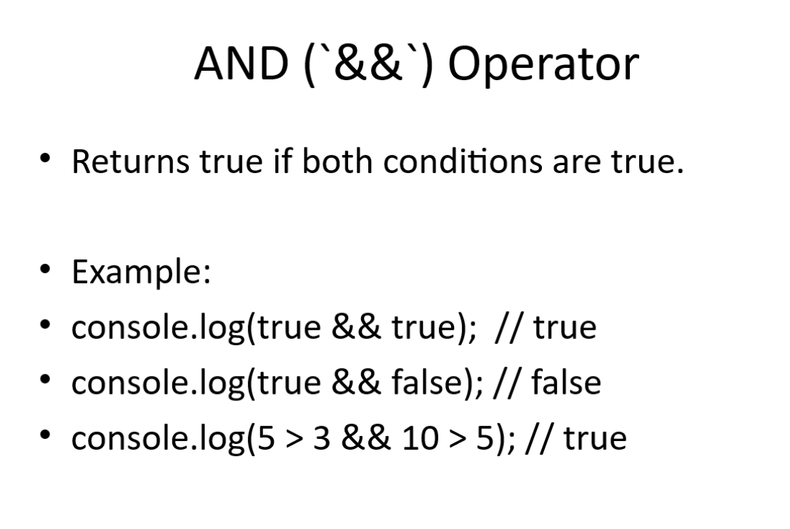

Slide 30
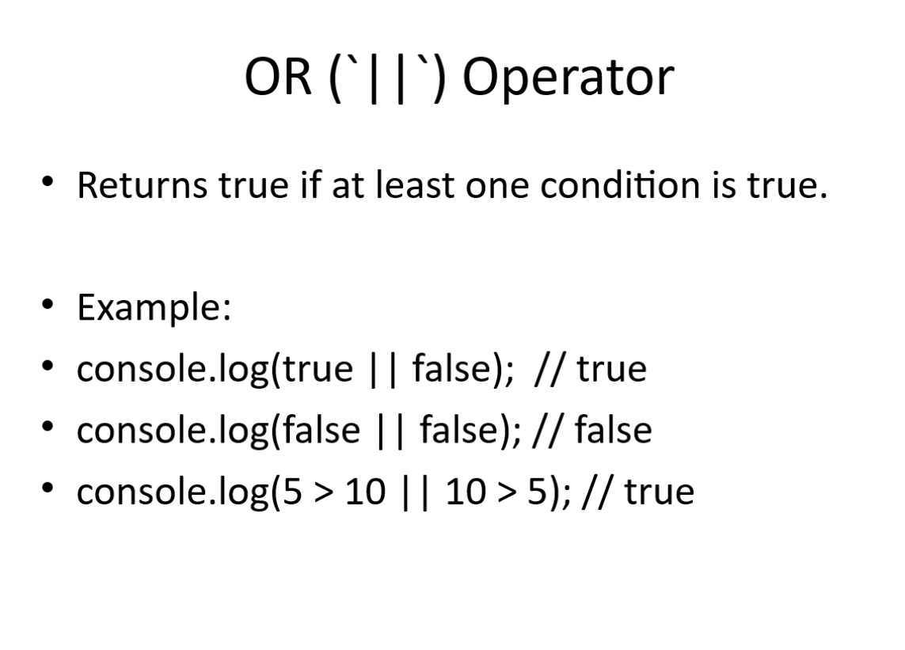

Slide 31
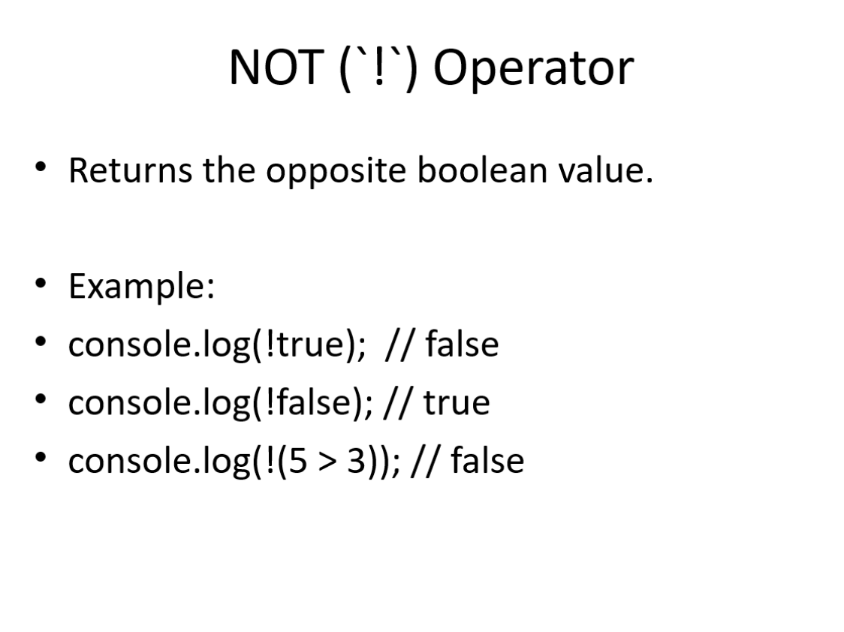

Slide 32
JavaScript Conditional (Ternary) Operator
Understanding Conditional (Ternary) Operators in JavaScript

Slide 33
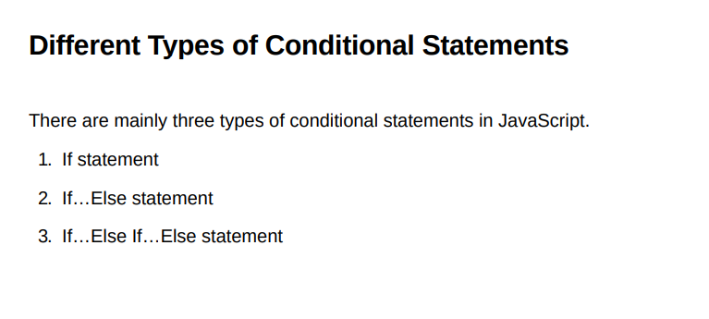

Slide 34
What is the Conditional (Ternary) Operator?
• The conditional (ternary) operator is a shorthand for the if-else statement.
• It has the syntax: condition ? expressionIfTrue : expressionIfFalse;
• It is useful for writing shorter and more readable conditional expressions.

Slide 35
Basic Syntax of Conditional Operator
Syntax:
condition ? expressionIfTrue : expressionIfFalse;
Example:
let age = 20;
let status = (age >= 18) ? 'Adult' : 'Minor';
console.log(status); // 'Adult'

Slide 36
Example 1: Checking Even or Odd Number
let num = 7;
let result = (num % 2 === 0) ? 'Even' : 'Odd';
console.log(result); // 'Odd'

Slide 37
Example 2: User Access Control
let isLoggedIn = true;
let message = isLoggedIn ? 'Welcome, User!' : 'Please log in';
console.log(message); // 'Welcome, User!'

Slide 38
Nested Conditional Operator
• Ternary operators can be nested for more complex conditions.
Example:
let score = 85;
let grade = (score >= 90) ? 'A' : (score >= 80) ? 'B' : 'C';
console.log(grade); // 'B'

Slide 39
When to Use Conditional Operators?
• Use for short, simple conditions to improve code readability.
• Avoid using for complex conditions; prefer if-else for clarity.
• Great for assigning values based on conditions.

Slide 40
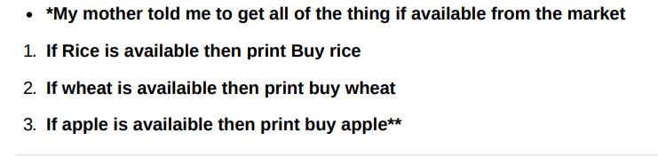
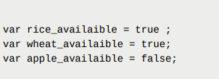

Slide 41


Q. Check Whether two names are equal or not
Q. Check which number is greater

Slide 42
Q. Given a char , you need to print whether the char is a vowel or not vowels : a, e, i, o, u

Slide 43
